Slide 1
Super Mart Grocery Sales
Annual Report

Slide 2
Content
Project Title
Data from SQL
Objective
Tool Used
Dashboard & insights
Link

Slide 3
Objective
.
To increase Super Mart’s grocery sales across India by delivering high-quality, affordable, and diverse grocery products while enhancing customer satisfaction and expanding our presence in both urban and rural markets.

Slide 4
Tool Used
1.Data Import & Integration
Get Data -Import data from CSV, databases
Power Query Editor-Clean, filter, and transform raw sales
Data Types-Format columns (Date,Text, etc.)
2.Data Modeling
Relationships- Link tables like Sales,Category, Subcategory,city.

Slide 5
3. DAX (Data Analysis Expressions)-Used to create KPIs and calculated measures: Measure Example DAX Formula Total Sales = SUM(Sales[Total Price])
4. Data visulazation -
Line Chart | Sales by Year
Bar/Column Chart | Sales by category, Subcategory
Donut/Pie Chart | Sales By City, Profit by Region
Matrix | Detailed tabular view by product/store
KPI Cards | Total Sales,Total Profit, Total Discount
Slicer | Region (Central,east, west,north south)
:

Slide 6
Bar/Column Chart Sales by category, subcategory
Donut/Pie Chart Profit by Region ,Sales by City
City

Slide 7
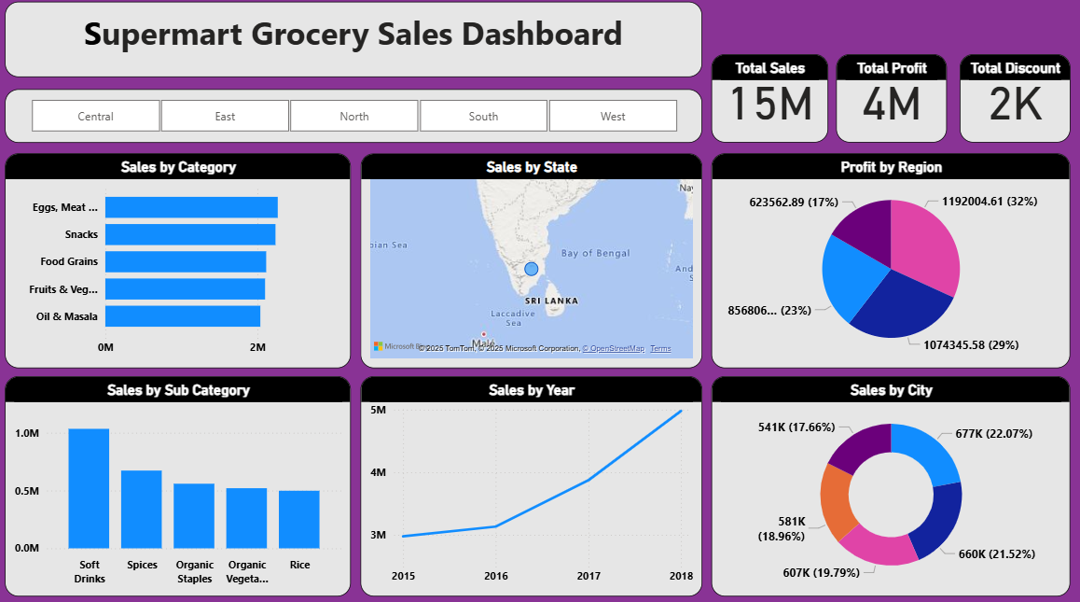
Output

Slide 8
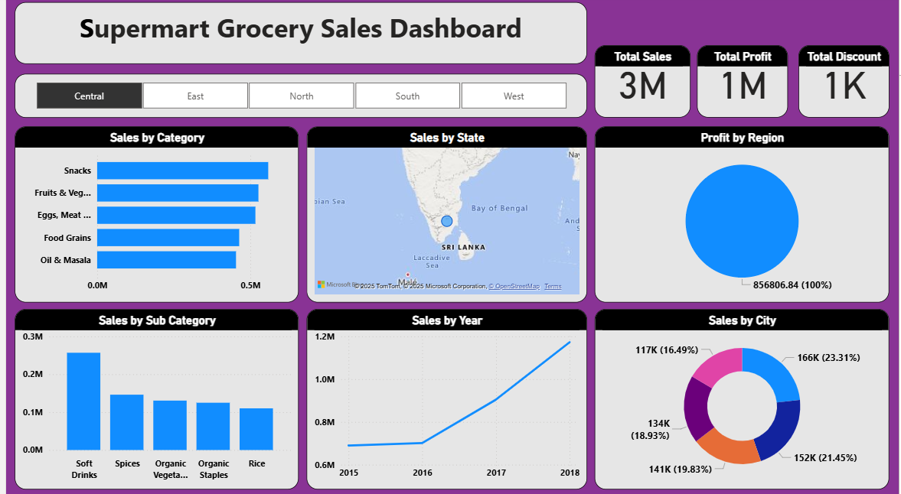
Central Region sales

Slide 9
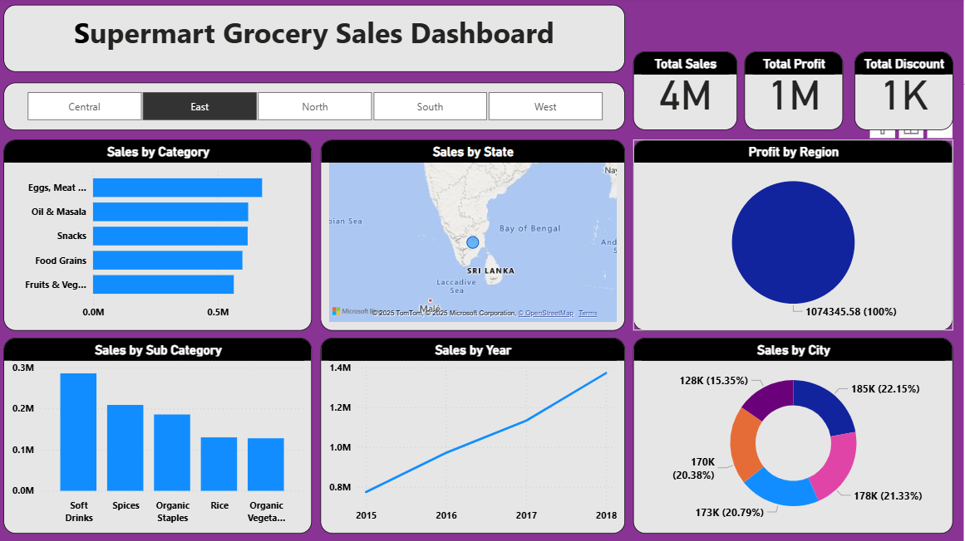
East Region Data

Slide 10
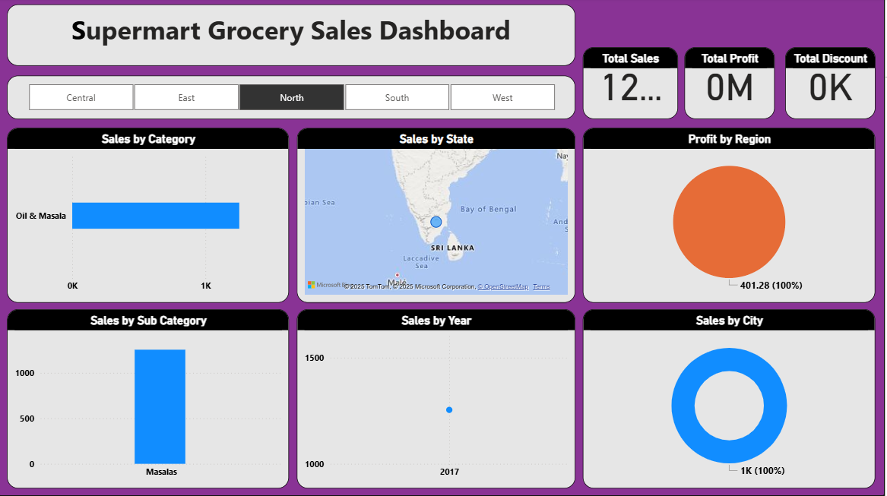
North Region Data

Slide 11
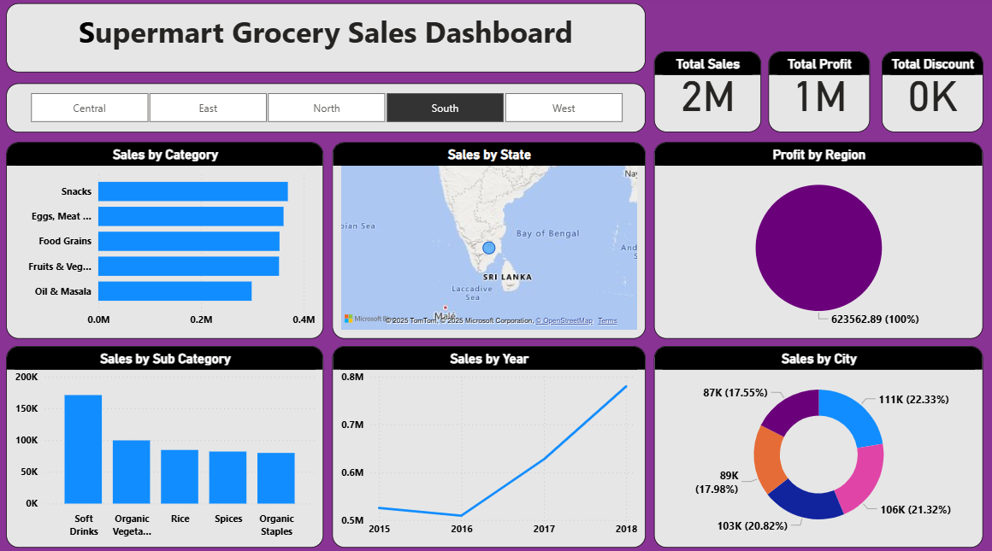
South Region Data

Slide 12
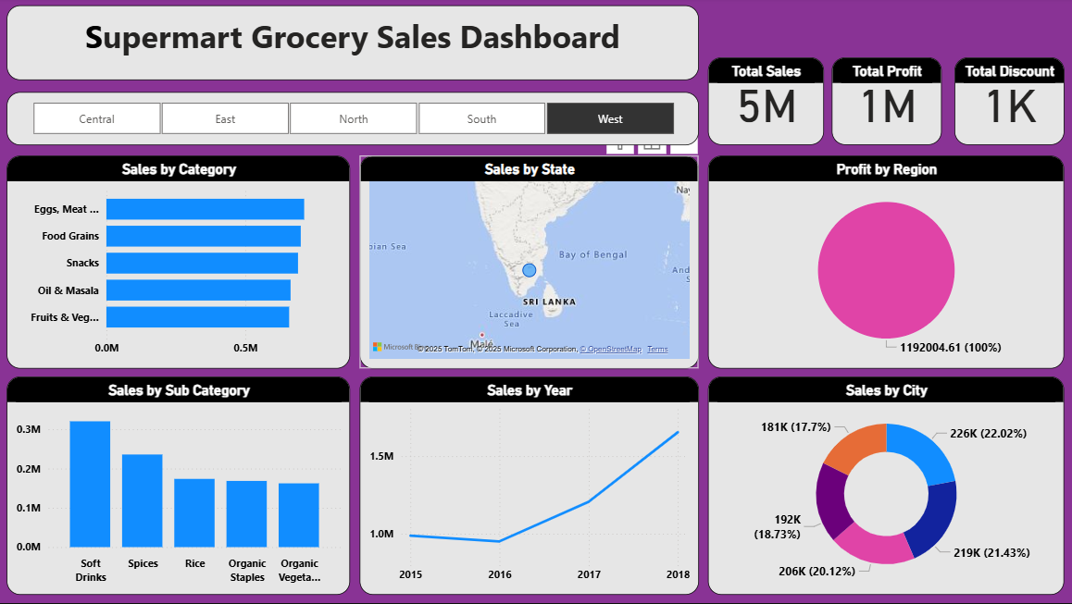
West Region Data

Slide 13
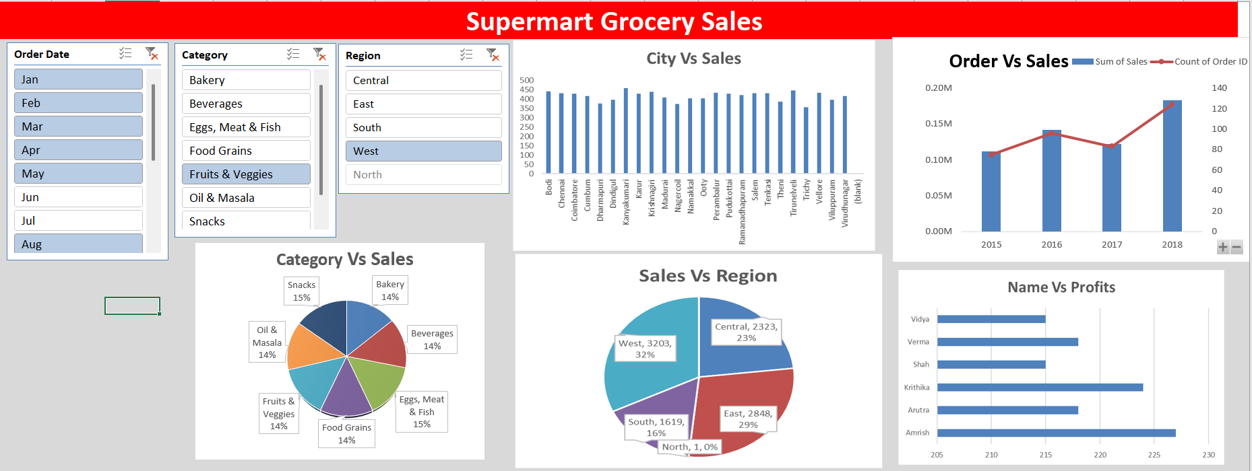

Slide 14
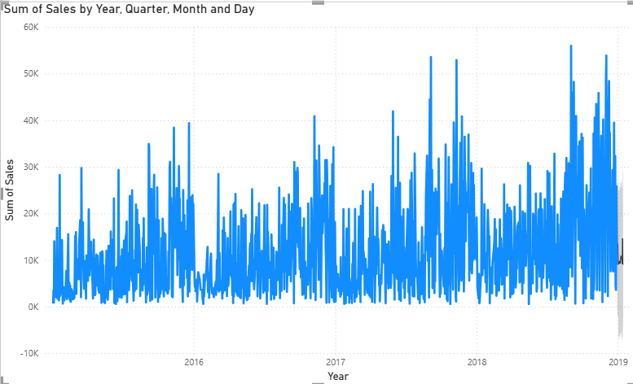
Forecasting

Slide 15
Insights
Hight Category sales - Snacks(558494
Low city sales - Viluppuram
Total Sale - 15K
Total Pofit – 4K
Total Discount – 2K
Hight sales 28/08/2018

Slide 16
Link

